Slide 1
Welcome to CSE 427 Machine Learning
S M RAFIUDDIN RIFAT

Slide 2
Machine Learning
A Computer program is said to learn from experience E with respect to some class of tasks T and performance P, if its performance at task in T, as measured by P, improves with experience E.
Example of playing checkers—
E = The experience of playing many games of checkers.
T = The task of playing checkers.
P = The probability that the program will win the next game.

Slide 3
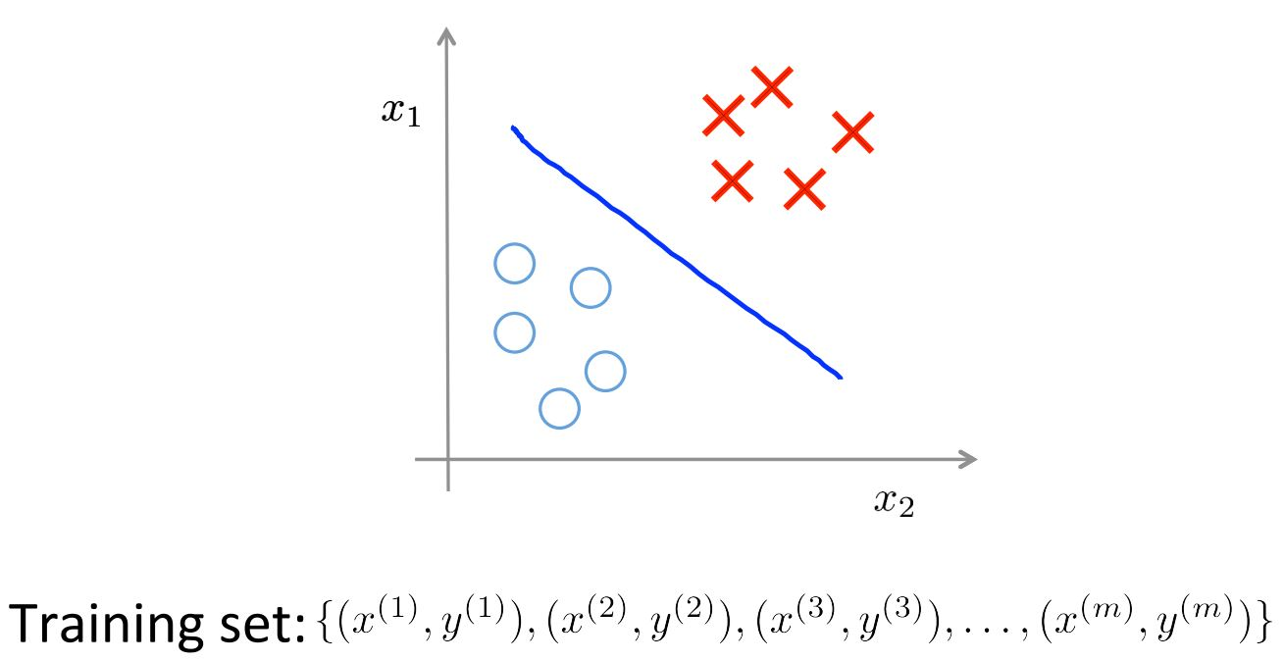
Supervised Learning

Slide 4
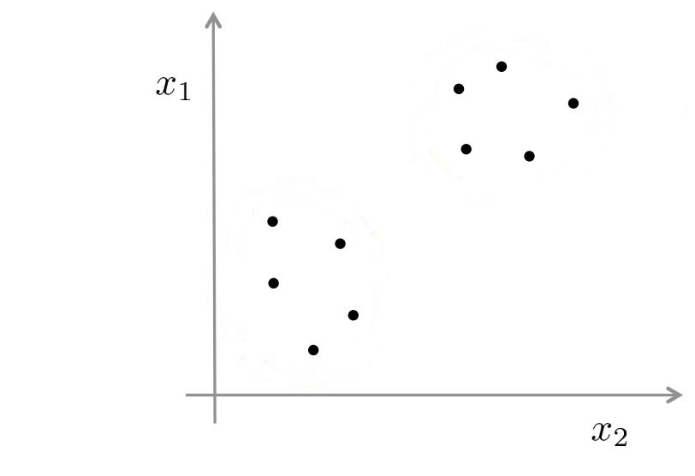
Unsupervised Learning
*No labeled data

Slide 5
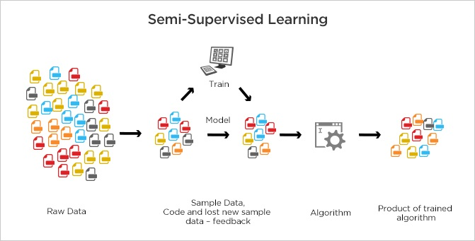
Semi-supervised Learning

Slide 6

Reinforcement Learning

Slide 7
4 Litter Bucket Problem
Just for fun!
Problem:
You have unlimited supply of water. You need to obtain exactly four litter of water (not more or less). But you have two containers. One is 3 litter bucket and another is 5 litter bucket. How could you obtain exactly 4 litters of water using only these two buckets?

Slide 8
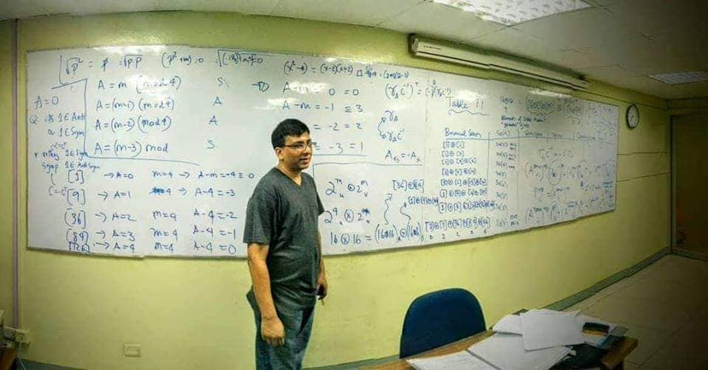
Pioneer Computer Scientist from Bangladesh
Dr. Mahbub Majumder

Slide 9
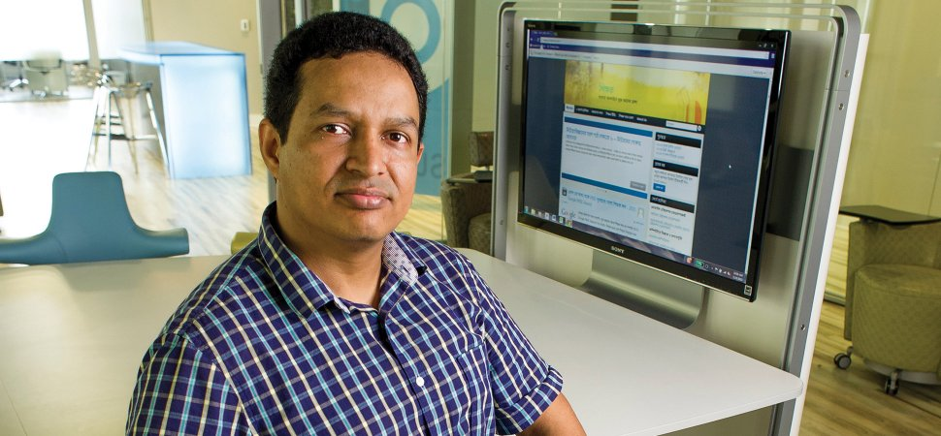
Pioneer Computer Scientist from Bangladesh (Cont’d)
Dr. Ragib Hasan

Slide 10
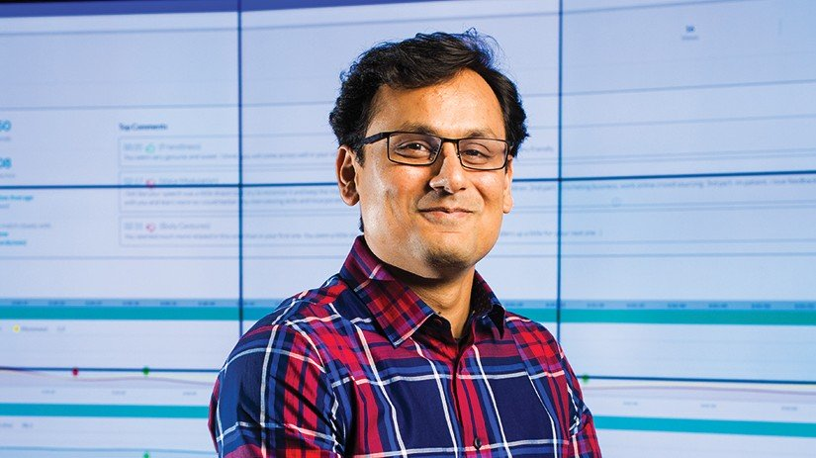
Pioneer Computer Scientist from Bangladesh (Cont’d)
Dr. Ehsan Haque

Slide 11

Pioneer Computer Scientist from Bangladesh (Cont’d)
Dr. Md. Shamsuzzoha Bayzid

Slide 12

Pioneer Computer Scientist from Bangladesh (Cont’d)
Dr. Nova Ahmed

Slide 13

Some of my Idols
Abdullah al Zubaer Imran
PhD Student, UCLA

Slide 14
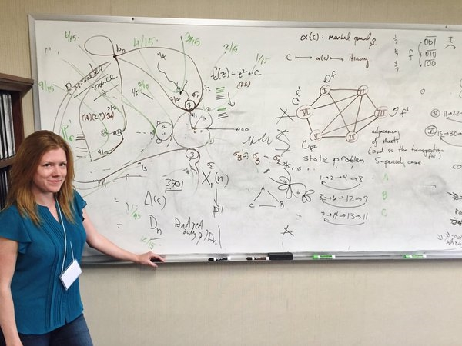
Some of my Idols
Dr. Holly Kreiger
Mathematician
Lecturer, Cambridge University

Slide 15
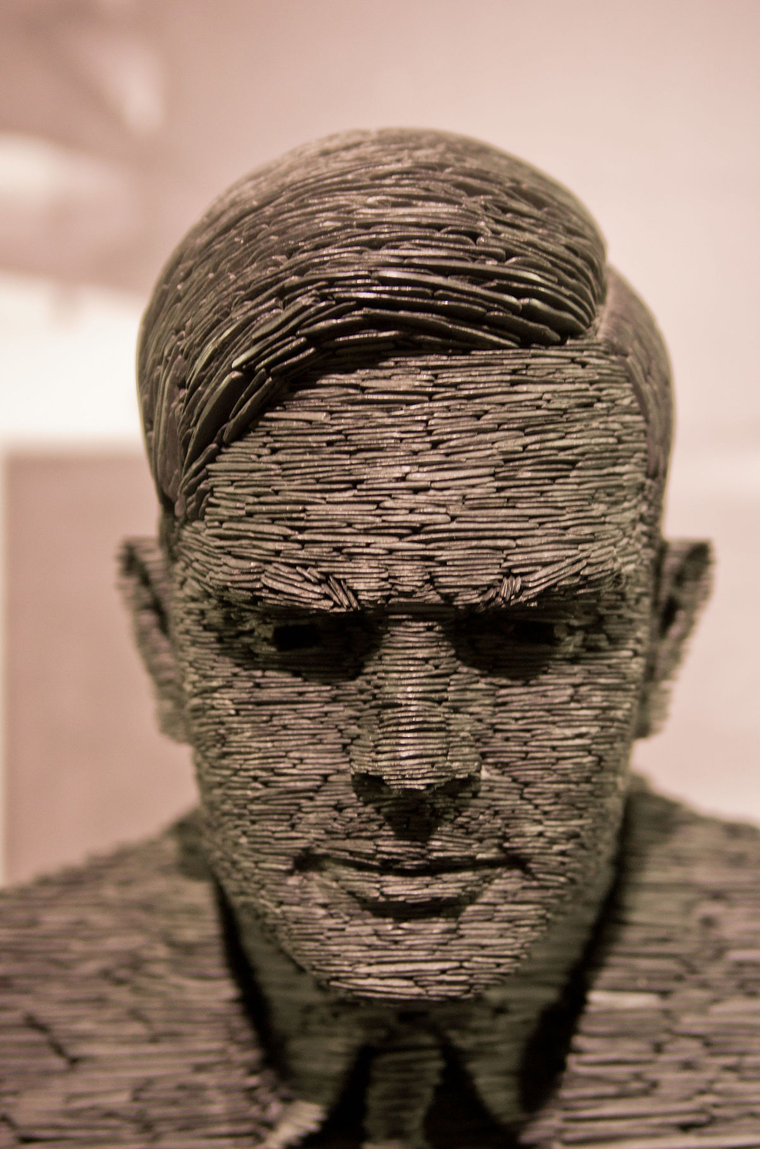
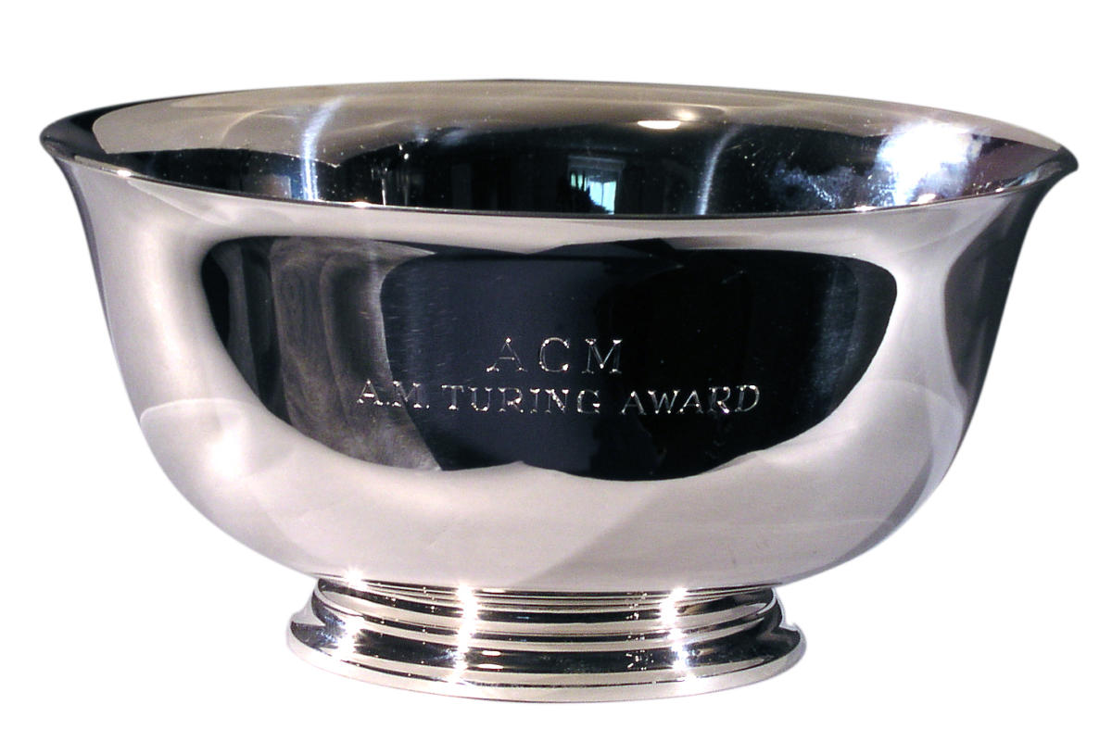
Nobel Prize of Computer Science
ACM A M TURING AWARD
Alan Mathison Turing

Slide 16
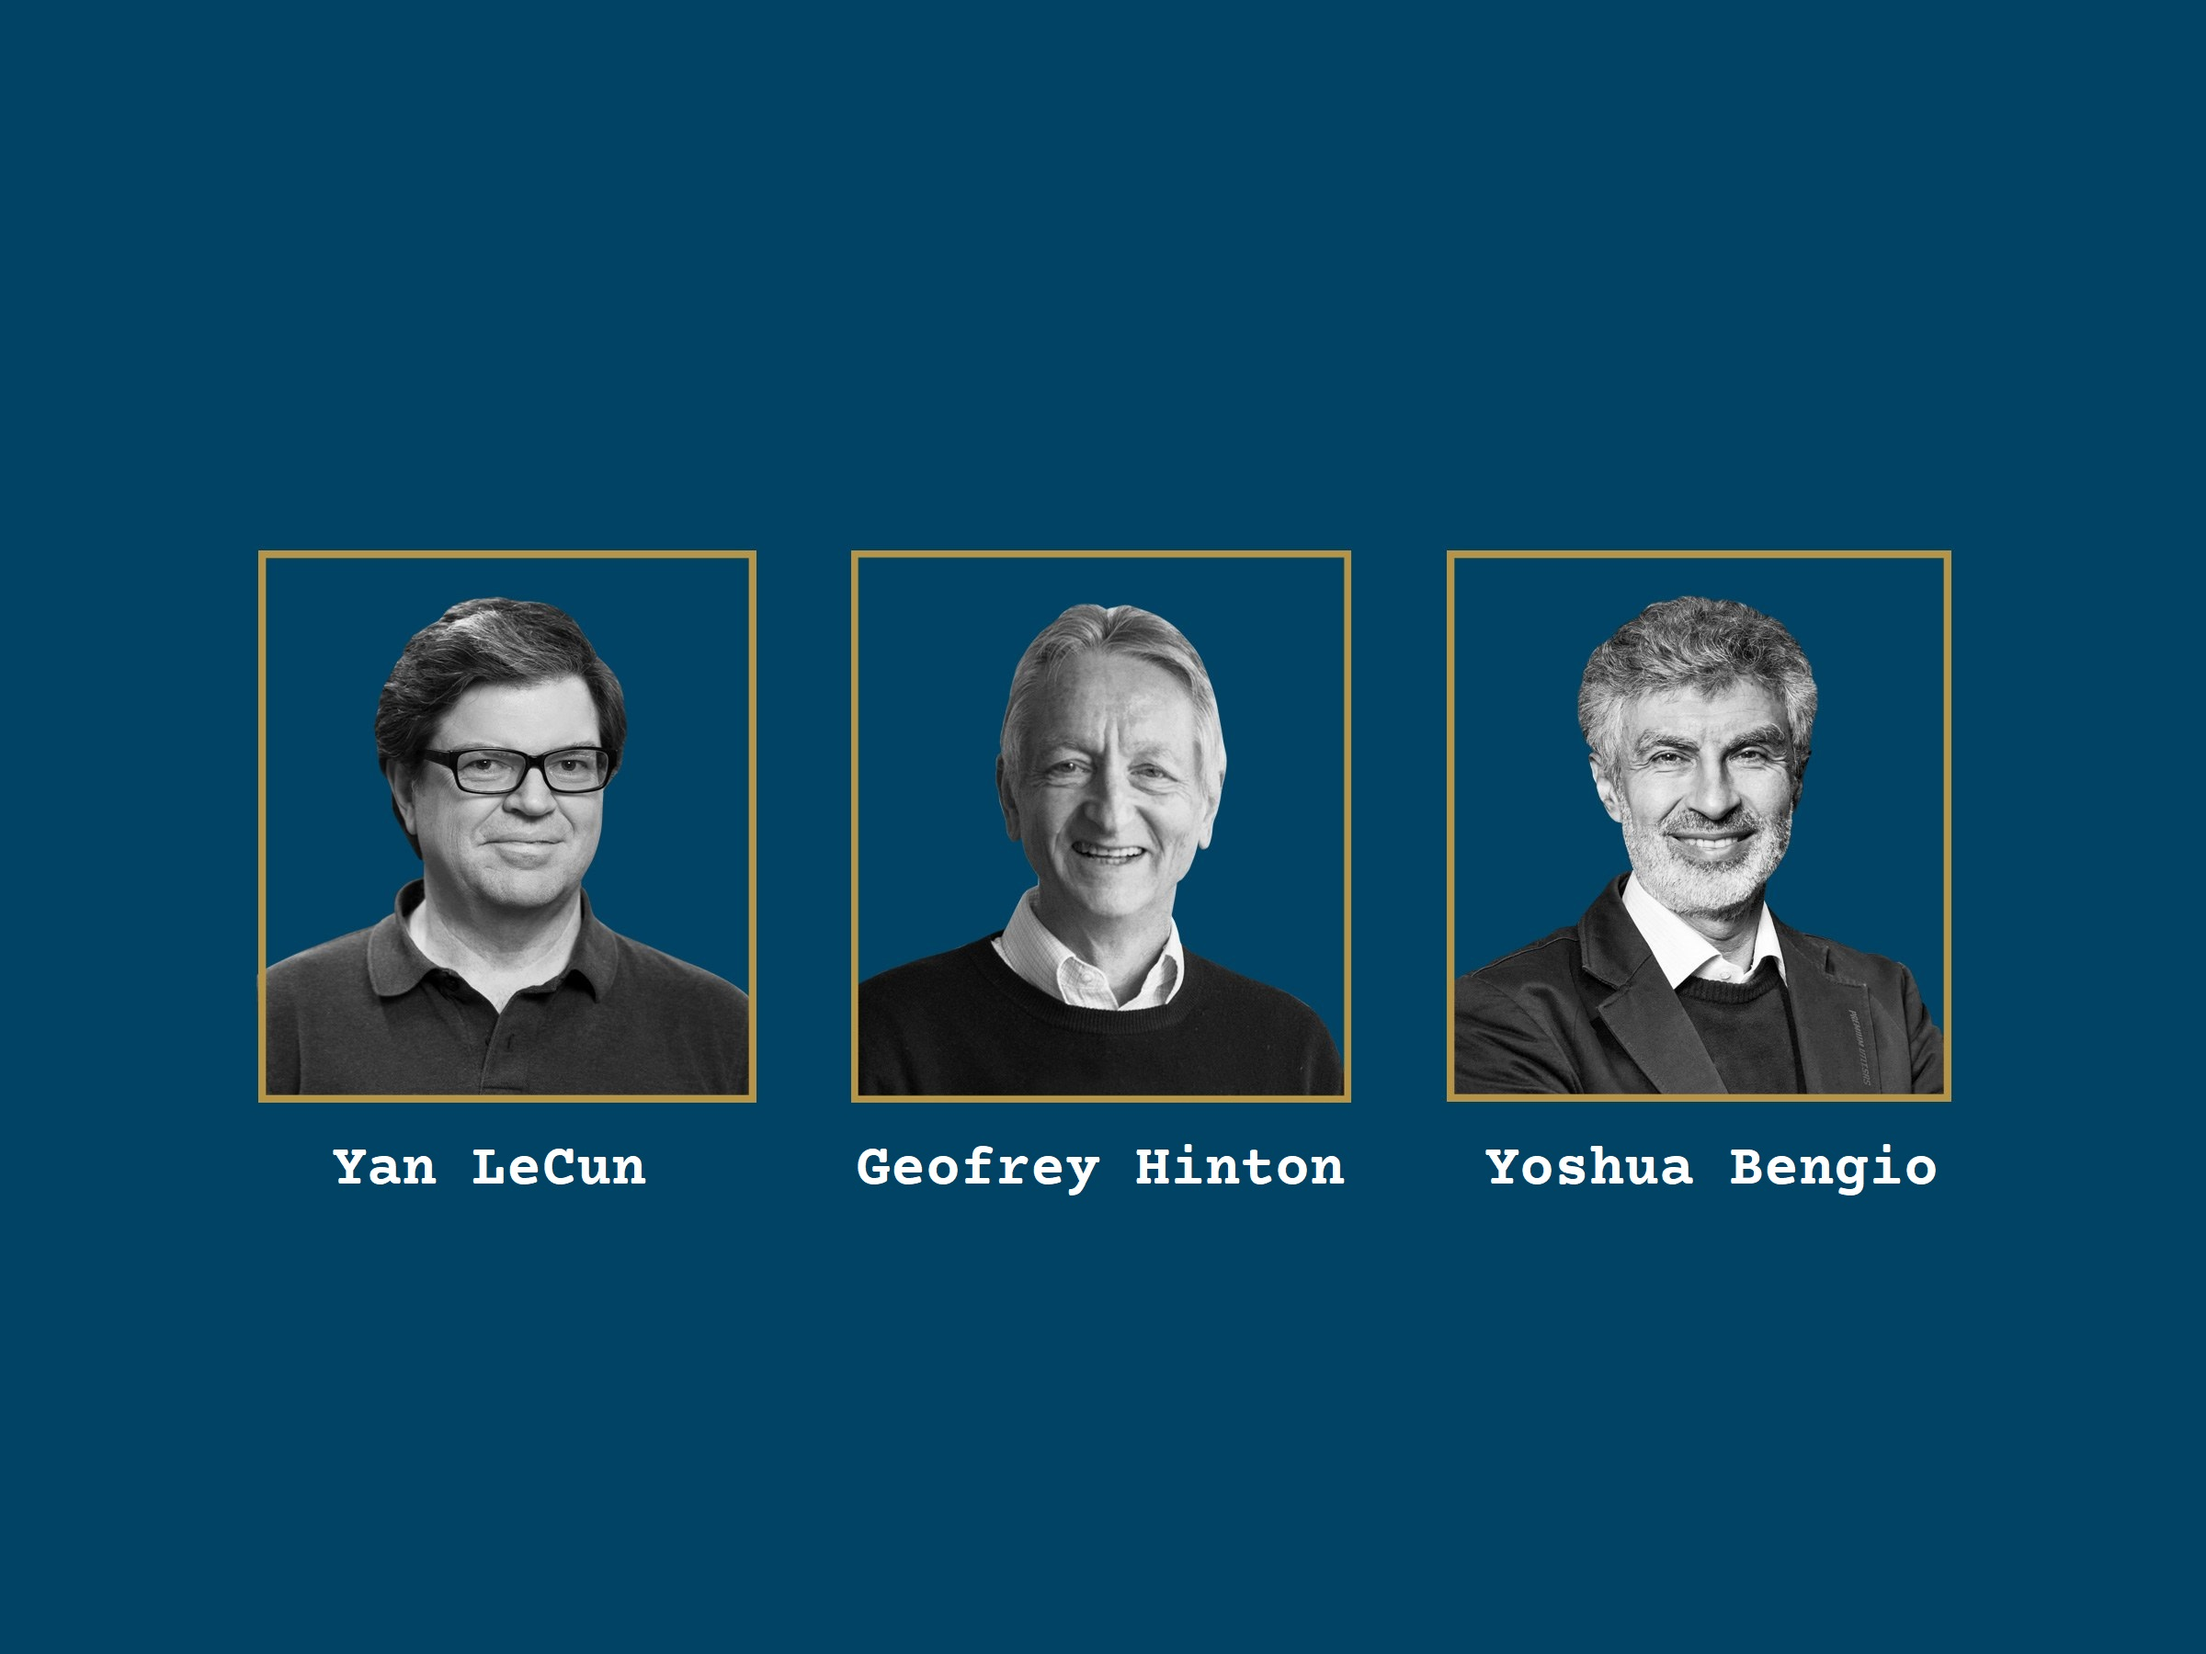
Turing Award 2018

Slide 17
Definition of Machine Learning
A computer program is said to learn from experience E with respect to some class of tasks T and performance measure P, if its performance at tasks in T, as measured by P, improves with experience E.

Slide 18
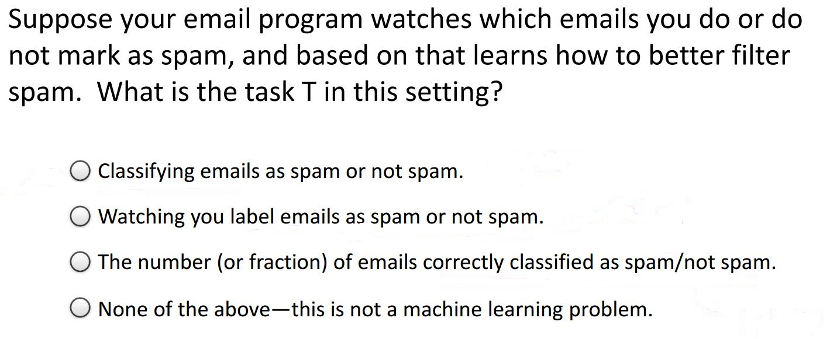
Example

Slide 19
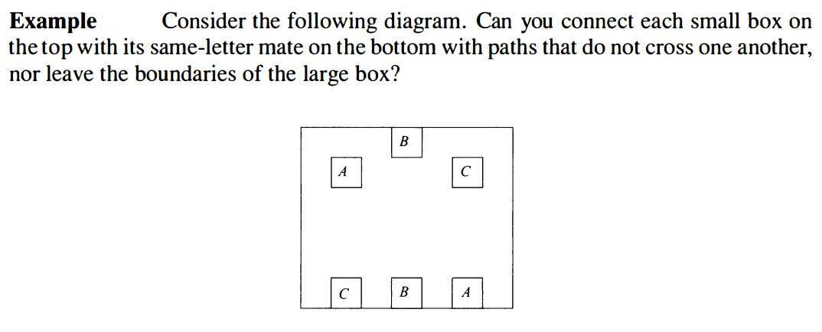

Slide 20
Google Class
Everyone must join google class.
All class lectures, notes, announcement, class test marks will be given through Google class.
Assignment submission may be collected from Google class submission.

Slide 21
Do’s and Don’ts
Do’s
Try to attend every class and took the lectures on your notebook.
Ask questions without any hesitation on topics.
Don’ts
Never talk with your fellow classmates while I’m giving lectures. It is very annoying.
Never ask one question – “What will be the questions from this lecture in exams”?

Slide 22
Evaluation
Quiz – 15%
Assignment – 15%
Midterm – 20%
Final – 50%
N.B.: Quiz and Assignment marks may vary on situations.

Slide 23
Consultation Hour
Given on Course Outline file.

Slide 24
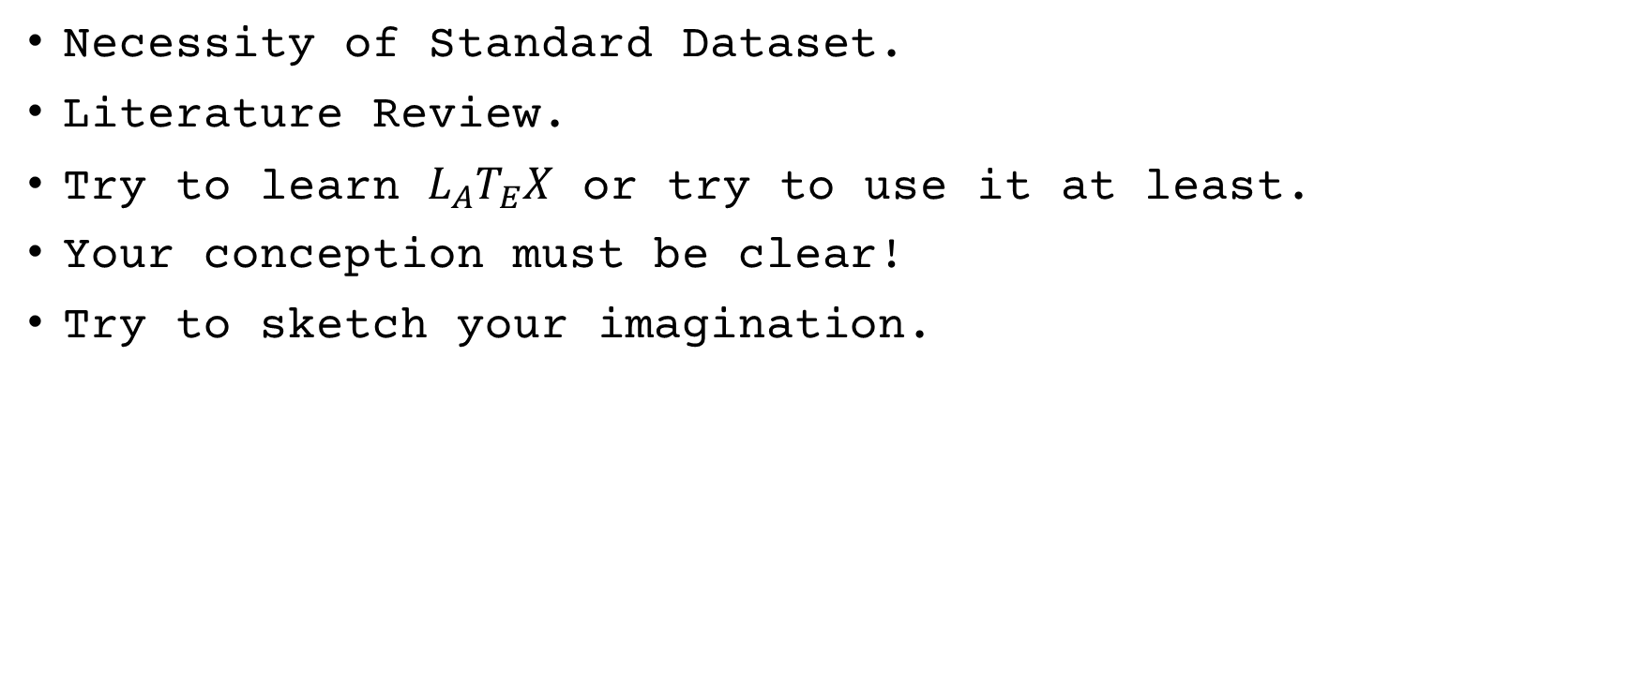
Find a Research Topic
Necessity of Standard Dataset.
Literature Review.
Try to learn $L_{A}T_{E}X$ or try to use it at least.
Your conception must be clear!
Try to sketch your imagination.

Slide 25
Reference Books
Pattern Recognition and Machine Learning – Christopher Bishop.
Introduction to Machine Learning – Tom Mitchel.
Youtube – Best source ever!
Kdnuggets – Blog on Data Science!
Medium.com – Handful of resources on Pattern Recognition.
MITOpenCourseWare
Coursera Machine Learning – Andrew Ng.
মেশিন লার্নিং অ্যালগরিদম – নাফিস নিহাল!

Slide 26
Thank you! Hope we’ll have a great journey recognizing how a machine learn!

